Slide 1
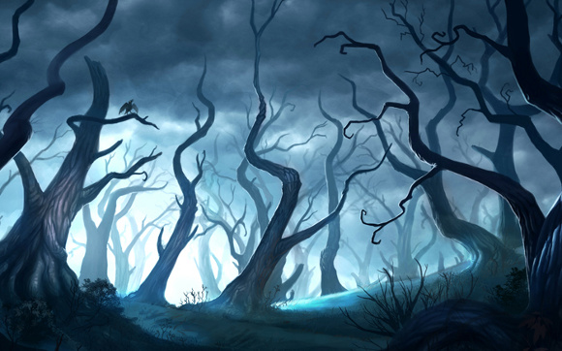
The Kingdom Of Valor
Notes:
Say our company name ,Say your name,Read the title

Slide 2
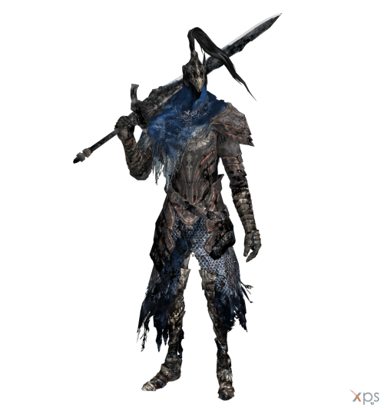

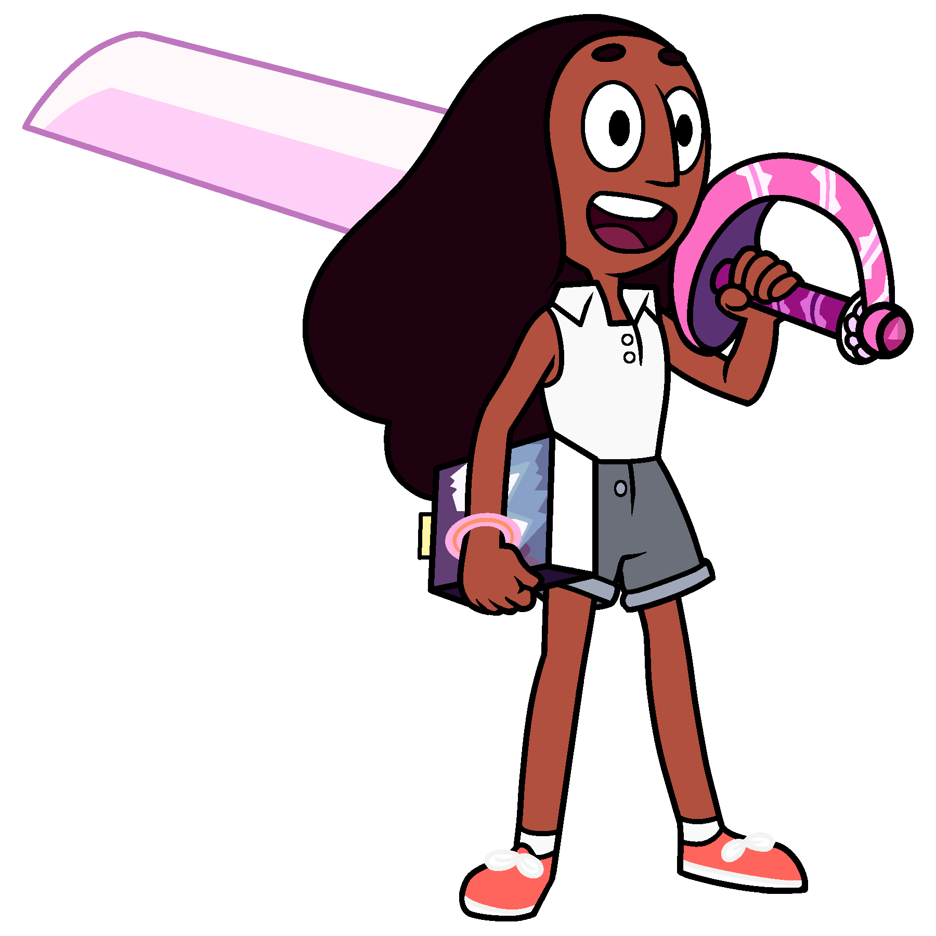

Level 1
Notes:
In this slide it shows the first level of the game where it starts off with the main character who has to defeat her first boss character. The boss has minions who protect him. To pass each level she has to defeat the people in her way and go through the portal

Slide 3
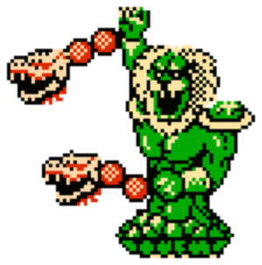
Level 2

Slide 4
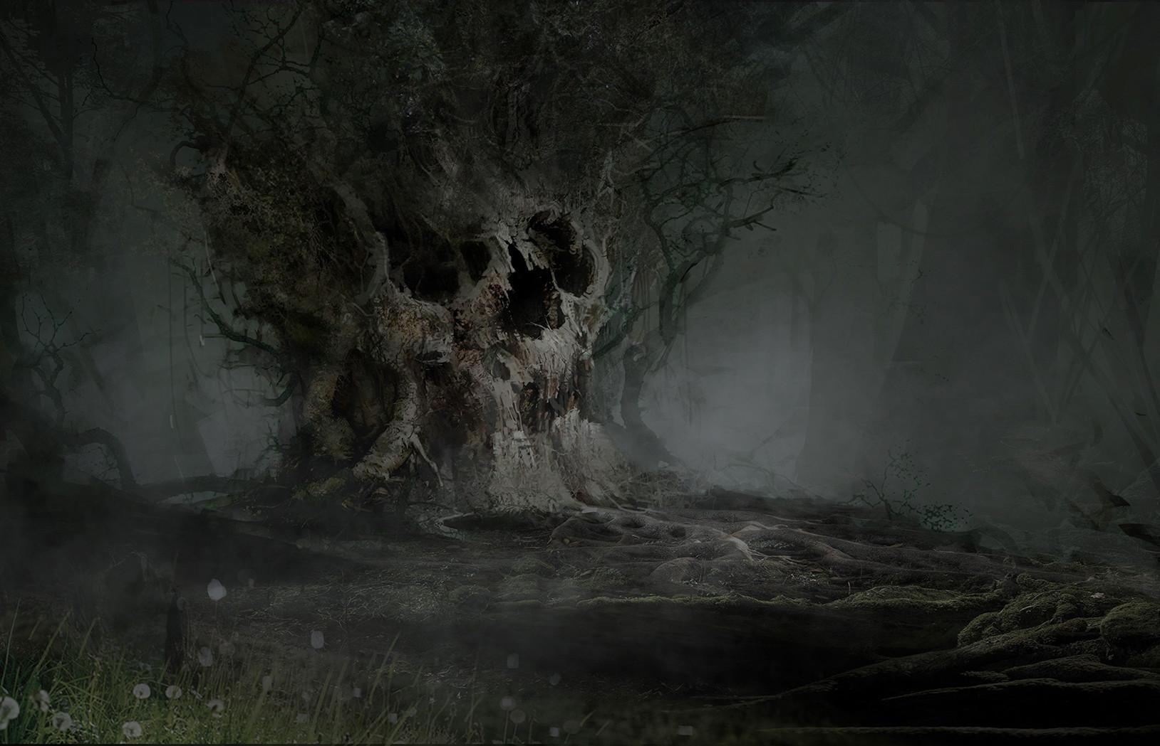
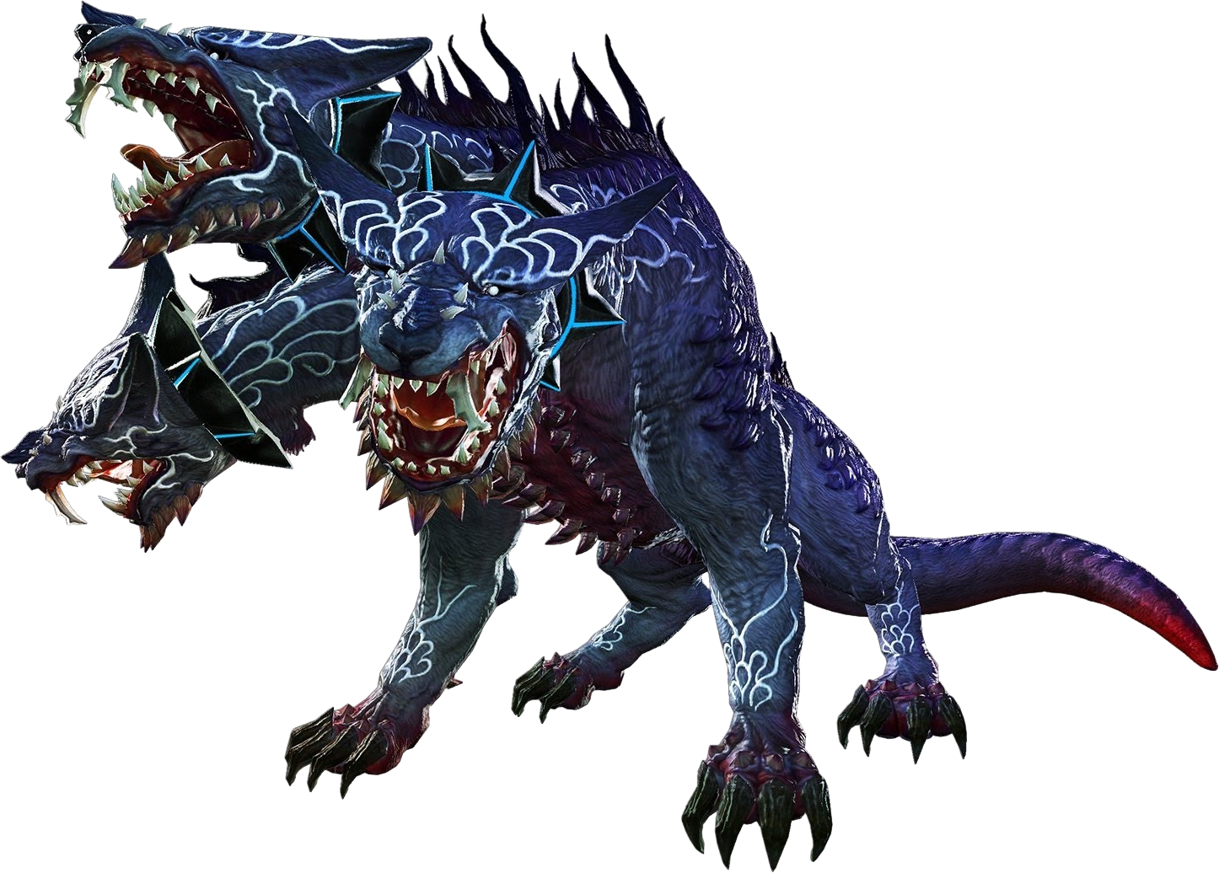
Level 3
Notes:
The third level of the game when the main character has to defeat a three headed dragon merged with wolf that has come out of a portal as another foe to try and stop the player from continuing her journey

Slide 5
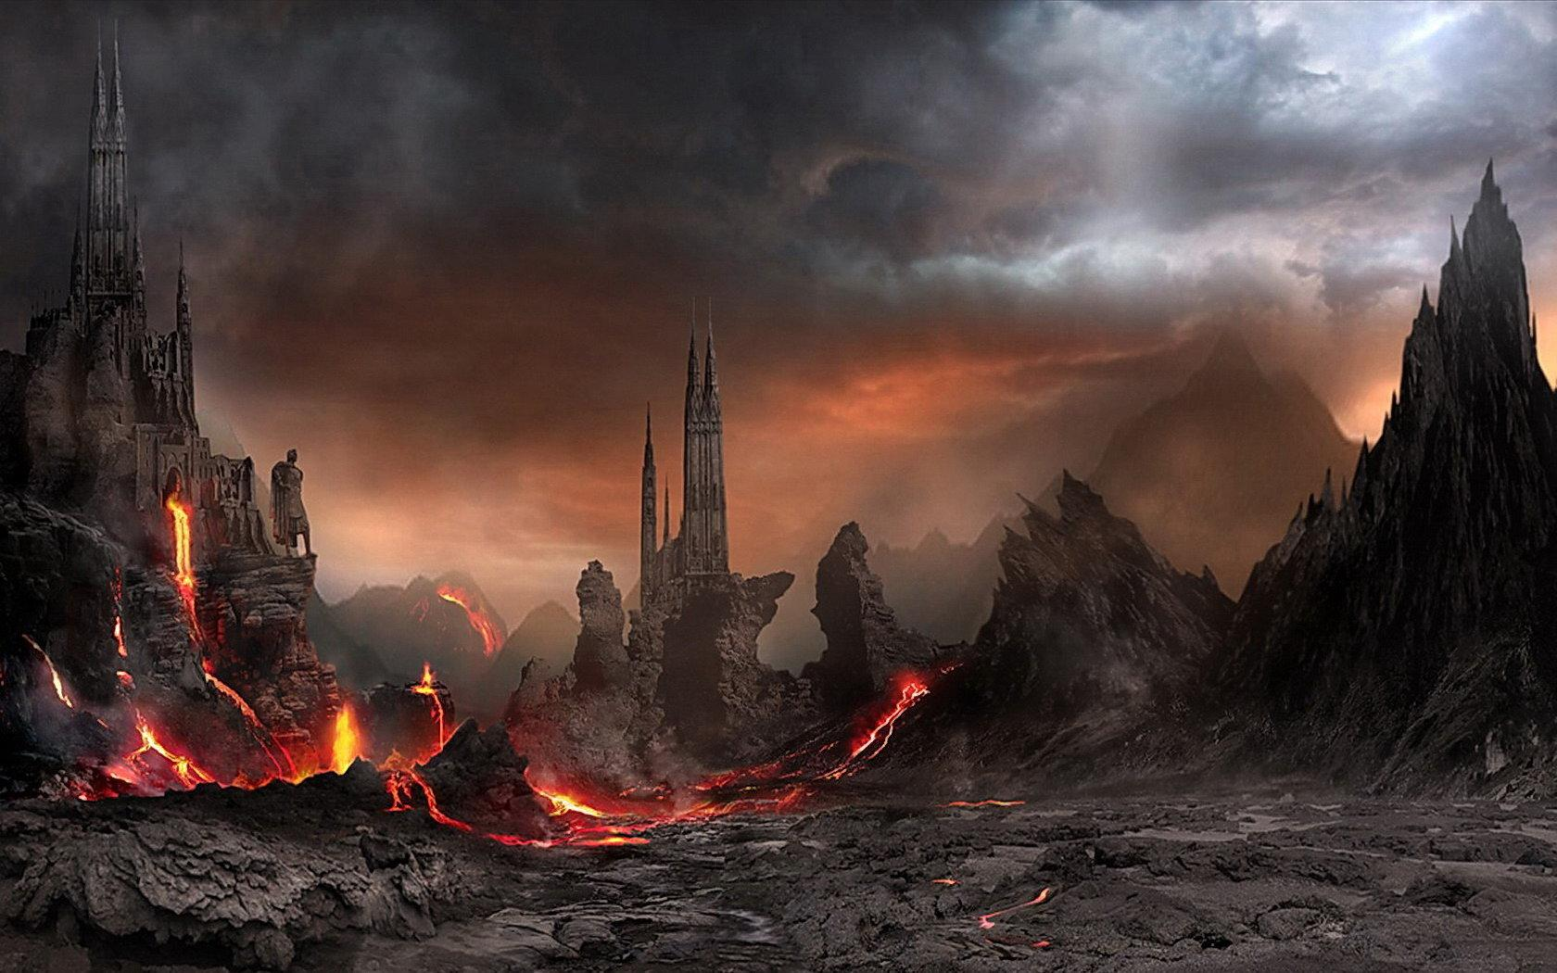
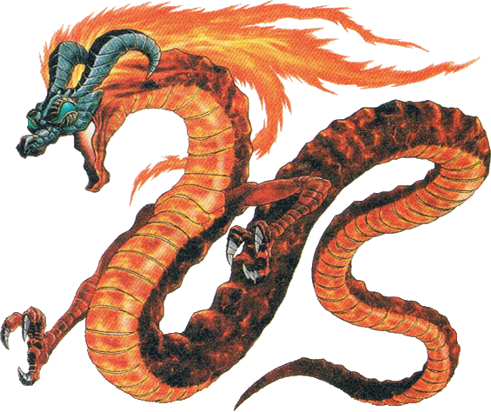
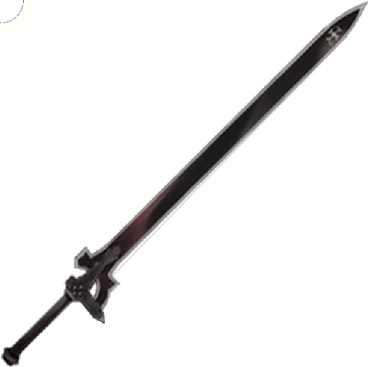
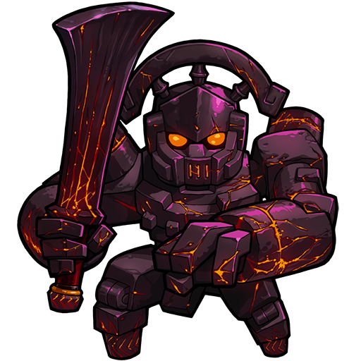
Level 4
Notes:
The hero fights the hardest boss of them all.

